Slide 1
Impact of COVID-19 imposed Lockdown on Health
Submitted by
Mr. Shubham Chakrabarti

Slide 2
ABSTRACT
This study was carried out to get a detailed summary about the participant’s daily habits and their lifestyle and to attempt to find a correlation between this and their change in weight during this time period so as to learn how different factors contribute to weight-gain and even obesity and what actions help prevent or control this.

Slide 3
INTRODUCTION
After the lockdown was imposed in a lot of countries and places and almost the entire general public everywhere were restricted to their homes. Being in a closed, confined area everyone’s daily activity reduced, sedentary hours increased and dietary patterns also were impacted.
During this period, health experts were in favour of continued exercise during this pandemic to avoid health problems, such as increasing obesity, depression, infections, and cardiovascular diseases, as much as possible.
Understanding what habits lead to weight gain can help us take more conscious decisions that reduce our chances of putting on weight and thus increasing the risk of heart disease, obesity, diabetes etc. as they cause lots of health problems and put us at risk of premature death.
As these lifestyle changes came into effect a lot of people either lost or gained weight. The aim of this particular study is to see the link between all these above-mentioned habits and weight change.

Slide 4
IDENTIFICATION OF RESEARCH GAP
AND PROBLEM
1) How long one should be sedentary.
2) How many meals should one have.
3) What activities help one lose weight
4) How long one should sleep/exercise
In this study we have tried to take a look into these topics and try and answer these questions by studying the relationship between these parameters and the weight of these individuals.

Slide 5
EXPECTED IMPACT
1) Change in the guidelines issued by bodies like WHO, CDC among others on how to stay healthy in such situations.
2) Help Fitness/Personal trainers, dieticians etc. To identify their client’s behaviours at an early stage and correct them to help reach their goal weight.
3) People will seek healthier options, pick other forms of exercises etc that align with their fitness goals.
4) To promote more studies regarding how a situation like a lockdown affects our bodies physically at a deeper level and also mentally.
5) To help the public understand about how, seemingly-small changes in one’s lifestyle can actually cause huge changes.

Slide 6
METHODOLOGY
150 participants took part in this study who were aged between 17 and 70, both men (59%) and women (41%). These participants were chosen at random, most of whom were based in India and had been under lockdown for 5 months at the time.
The participants were asked questions like how often they exercised and ate junk food, how long they slept for and their sedentary hours daily, they were also asked their chosen mode of exercise and most importantly how much weight they lost/gained during the lockdown. Apart from these, they were asked basic questions like their age, name and gender.
Since the participants reported the data themselves as there was an unavailability of labs, the participants were made to submit their mean weight of three days (in a fasted state after waking up) for the before and after weights and the difference was recorded.

Slide 7
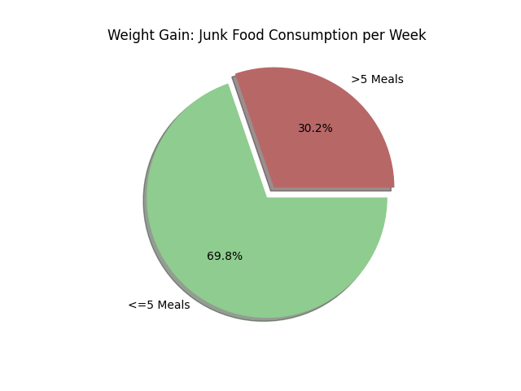

Slide 8
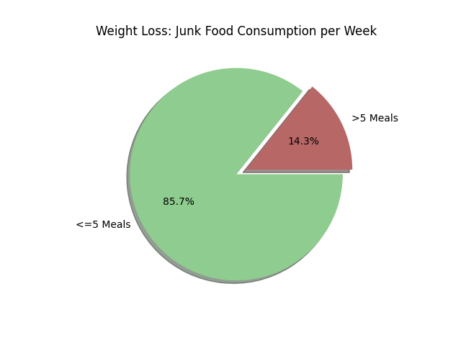

Slide 9
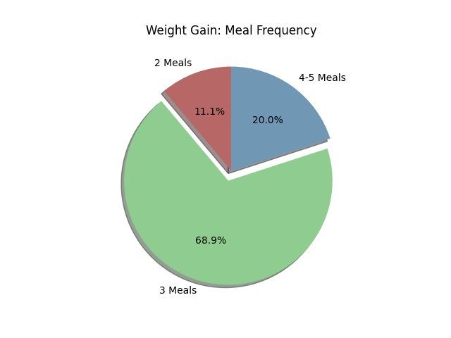

Slide 10
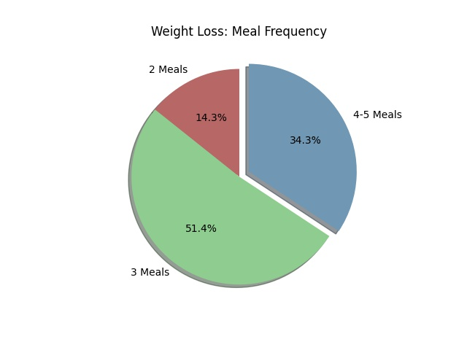

Slide 11
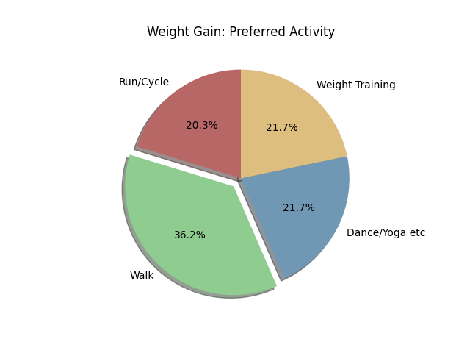

Slide 12
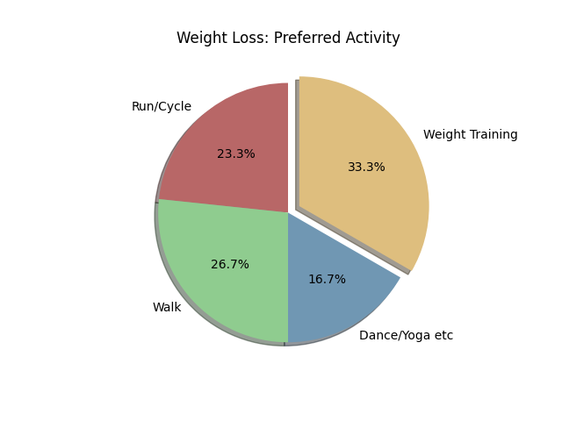

Slide 13
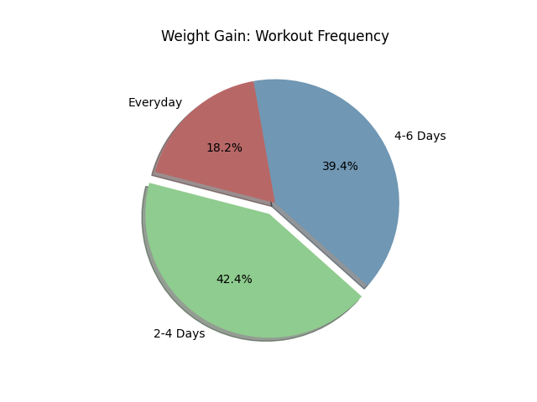

Slide 14
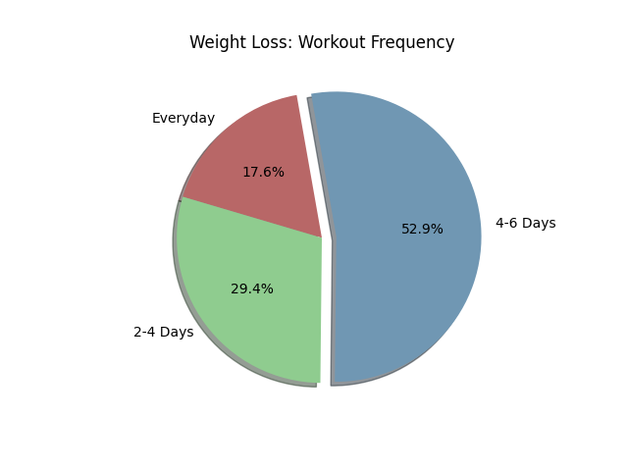

Slide 15
DISCUSSION
Reduction of Junk Food consumption
Importance of Meal Frequency
Differences between and advantages of Aerobic and Anaerobic Exercise
Importance of Workout Frequency

Slide 16

THE END

